Slide 1
Lesson 5
Tuple . Print variations. Collatz Conjecture . Caesar Cypher . Coin Flip Simulation

Slide 2
Administrative
Practical Test changed to Lesson 7 ( T2W1)

Slide 3
Lesson Objectives
tuple
print variations
Discussion of problems:
Chinese zodiac
Collatz conjecture
Caesar Cipher
Coin Flip Simulation

Slide 4
Tuple → ( )
Immutable version of list
Methods for tuple:
index → returns the index of the first occurrence of parameter
count → returns the number of occurrence of parameter
Cannot append, pop, insert … etc (trying to mutate the array)
Good for keep a data that does not change:
Encryption key, grading system … etc

Slide 5
print variations
print( , sep = ‘ ’)
print( , end = ‘’)
print( ,sep = ‘’,end = ‘’)

Slide 6
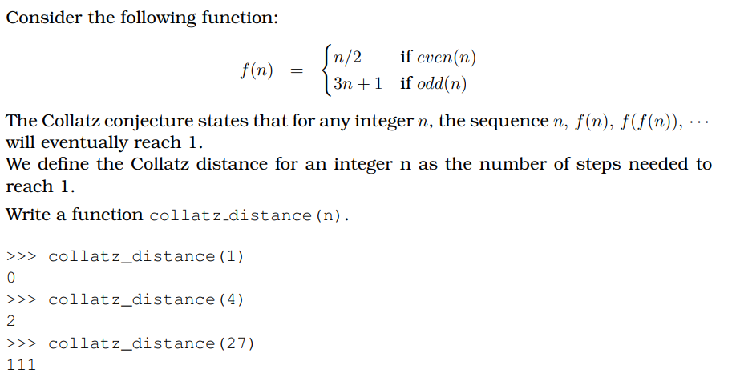
Collatz Conjecture

Slide 7
Caesar Cipher
The Caesar Shift Cipher is a type of substitution cipher where each letter in the original plaintext message is replaced by a letter some fixed number of positions down the alphabet.
It is named after Julius Caesar, who used it in his private correspondence.
The table below shows an example where the letters have been shifted to the right by 3.
Note that the letters “wrap-around” at the end.
a | b | c | d | e | f | g | h | i | j | k | l | m | n | o | p | q | r | s | t | u | v | w | x | y | z
d | e | f | g | h | i | j | k | l | m | n | o | p | q | r | s | t | u | v | w | x | y | z | a | b | c

Slide 8
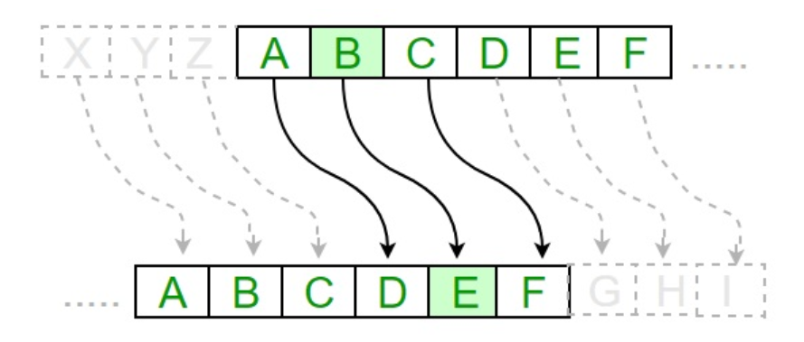

Slide 9
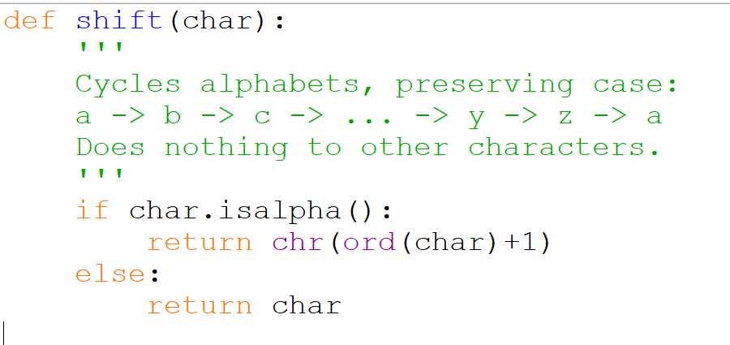
shift in one character
string.isalpha() returns True if is an alphabet, False otherwise
Something is missing !

Slide 10
Cipher – 2
Write a function to implement the encryption using the Caesar cipher with a key
You are to use the shift function done in cipher – 1
Write a function to decrypt the cipher text, using the brute force approach
Hint: you use the encryption to decrypt the code with different keys and output all possible original text

Slide 11
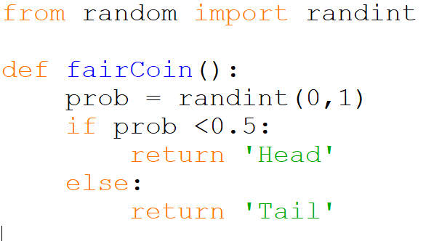
Head or Tail

Slide 12
Coin Flip Simulation
What’s the minimum number of times you have to flip a coin before you can have three consecutive flips that result in the same outcome (either all three are heads or all three are tails)?
What’s the maximum number of flips that might be needed? How many flips are needed on average?
In this exercise we will explore these questions by creating a program that simulates several series of coin flips.

Slide 13
Coin Flip Simulation
Create a program that uses Python’s random number generator to simulate flipping a coin several times. The simulated coin should be fair, meaning that the probability of heads is equal to the probability of tails. Your program should flip simulated coins until either 3 consecutive heads of 3 consecutive tails occur.
Display an H each time the outcome is heads, and a T each time the outcome is tails, with all of the outcomes shown on the same line. Then display the number of flips needed to reach 3 consecutive flips with the same outcome. When your program is run it should perform the simulation 10 times and report the average number of flips needed.

Slide 14
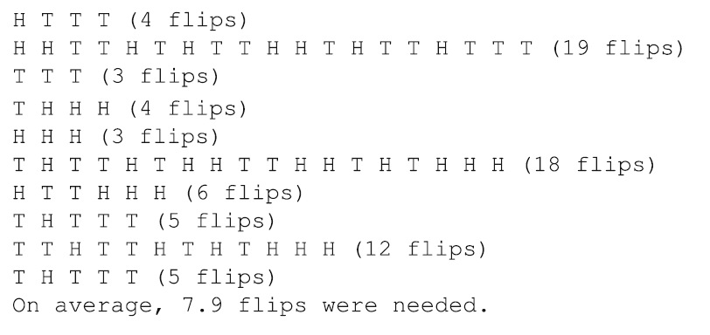
Coin Flip Simulation

Slide 15
Work to do . . .
5A – Control Structures
Revision 2
Programming Assignment 5
Cipher – 2
Coin Flip Simulation

